Slide 1

بِسْمِ ٱللَّٰهِ ٱلرَّحْمَٰنِ ٱلرَّحِيمِ
Conversational AI: A New Era of Interaction

Slide 2
Team Members
Zulqarnain Hassan
Ehsan Mehmood
Mumtaz Ali
Mursal

Slide 3

Conversational AI in HCI
how conversational AI is transforming human-computer interaction.

Slide 4
Chatbots: The New Interface
Interactive
Personalized
Chatbots provide a more intuitive and natural way to interact with technology.
They can learn user preferences and tailor their responses accordingly.

Slide 5

Voice Assistants: Beyond the Screen
1
Hands-free
2
Contextual
Voice assistants enable users to interact with technology without needing to touch a screen.
They can understand the context of the user's request and provide more relevant responses.
3
Multimodal
Voice assistants often integrate with other devices and services to provide a seamless experience.

Slide 6

Conversational AI in Healthcare
Symptom Monitoring
Medication Reminders
Chatbots can collect and analyze patient symptoms to help diagnose illnesses.
Voice assistants can provide timely medication reminders to improve adherence.
Mental Health Support
Conversational AI can offer support for mental health conditions, providing resources and guidance.

Slide 7
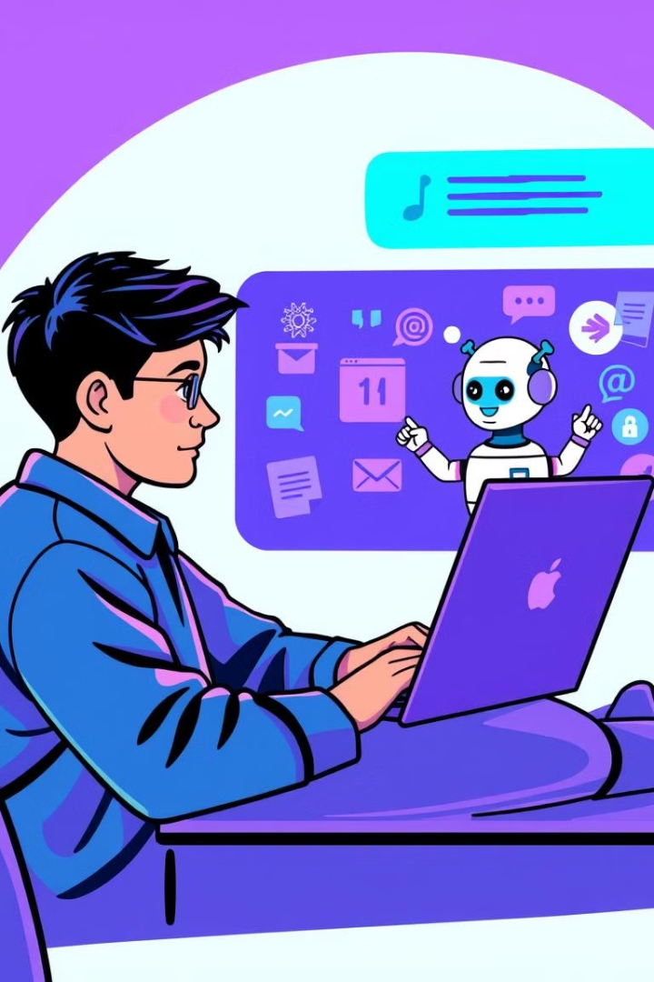



Conversational AI in Education
Personalized Learning
Immediate Feedback
Chatbots can tailor educational content to the individual needs of students.
They provide immediate feedback on assignments and help with understanding concepts.
Interactive Learning
Chatbots make learning more engaging and interactive, fostering active participation.

Slide 8

Conversational AI in Customer Service
24/7 Availability
Personalized Support
Chatbots can provide assistance around the clock, improving customer satisfaction.
Chatbots can tailor their responses to the individual needs of each customer.
1
2
3
Efficient Problem Solving
They can quickly answer frequently asked questions, freeing up human agents for more complex tasks.

Slide 9
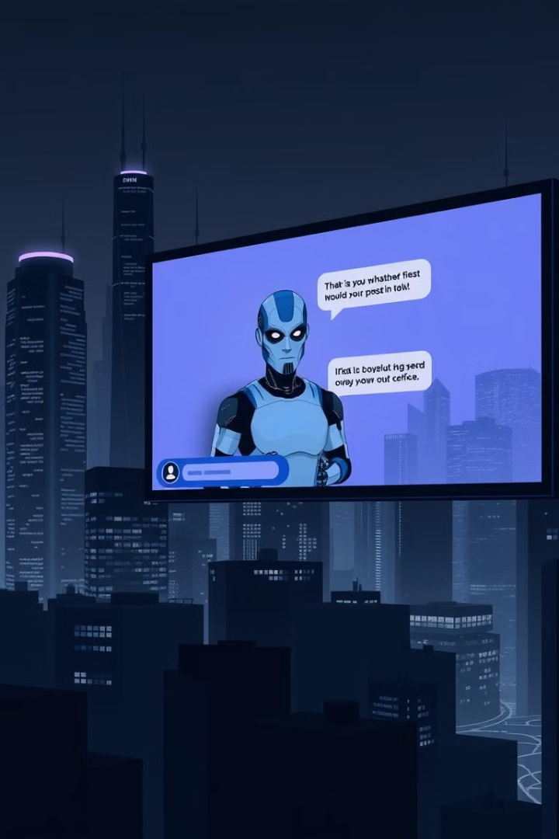



Ethical Considerations
Privacy
Conversational AI collects vast amounts of data, raising concerns about user privacy.
Bias
Chatbots can reflect biases present in their training data, potentially leading to unfair or discriminatory outcomes.
Transparency
It's important to be transparent about the capabilities and limitations of conversational AI.

Slide 10

The Future of Conversational AI
Conversational AI is poised to continue reshaping the landscape of human-computer interaction, leading to a more personalized, intuitive, and seamless experience.

